Slide 1
Vacation Rental
Temporary Use Permits (TUP)
Planning & Development Committee
October 5, 2023

Slide 2
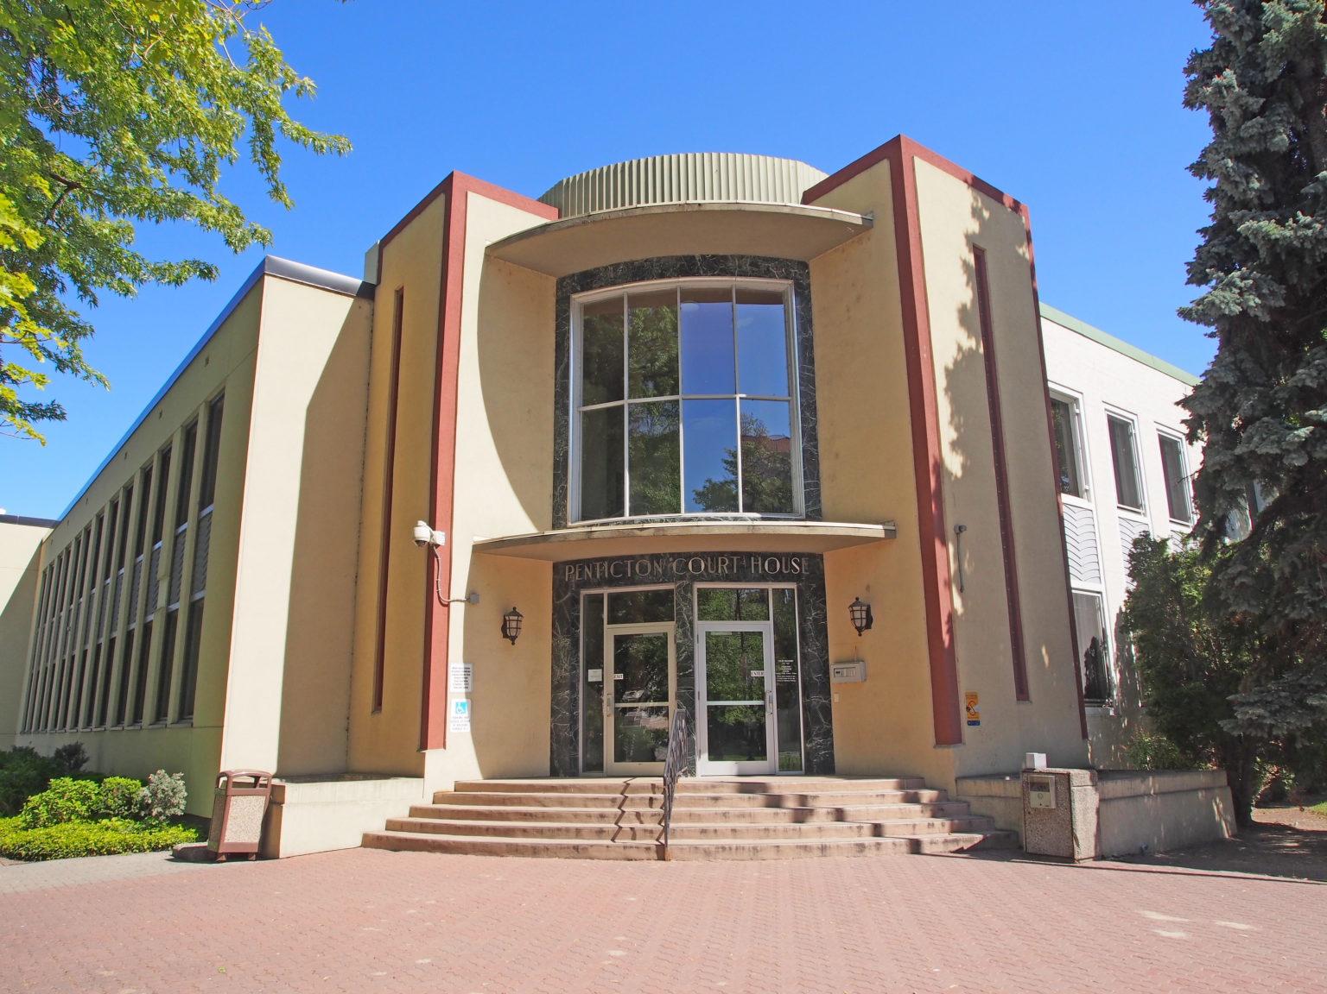
Supreme Court Decision - 2012

Slide 3
Vacation Rental Use Regulations Introduced
Separate Bed & Breakfast and Vacation Rental uses;
Resolved to regulate Vacation Rental uses through Temporary Use Permit (TUP) applications;
Electoral Area OCP Bylaws amended to support policy direction;
Electoral Area Zoning Bylaws amended to prohibit Vacation Rental uses in all zones other than at Apex and Twin Lakes;
Adoption of Vacation Rental Enforcement Board Policy.

Slide 4
OCP Vacation Rental Criteria
Capability of accommodating on-site domestic water and sewage disposal;
Mitigation measures (e.g., screening & fencing);
Provision of adequate off-street parking;
Confirmation that structure complies with BC Building Code; and
Benefits that the accommodation may provide to the community;

Slide 5

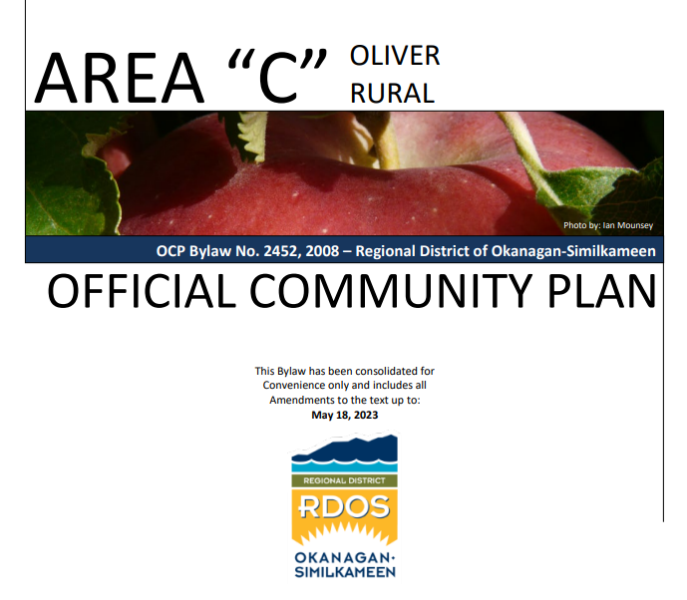

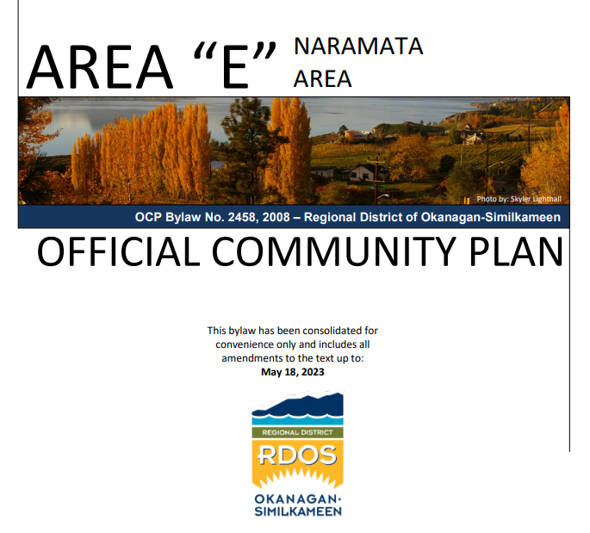
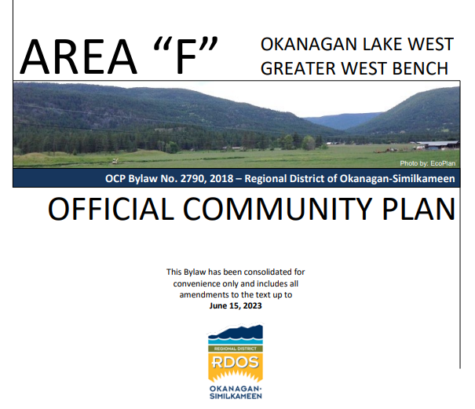
Vacation Rental OCP Policies
Supports on-going vacation rentals on Residential designated properties through the issuance of a TUP
Supports short-term rental of residences provided that community and neighbourhood needs and other land use needs can be addressed

Slide 6
Vacation Rental Use Regulations Introduced
Separate Bed & Breakfast and Vacation Rental uses;
Resolved to regulate Vacation Rental uses through Temporary Use Permit (TUP) applications;
Electoral Area OCP Bylaws amended to support policy direction;
Electoral Area Zoning Bylaws amended to prohibit Vacation Rental uses in all zones other than at Apex and Twin Lakes;
Adoption of Vacation Rental Enforcement Board Policy.

Slide 7
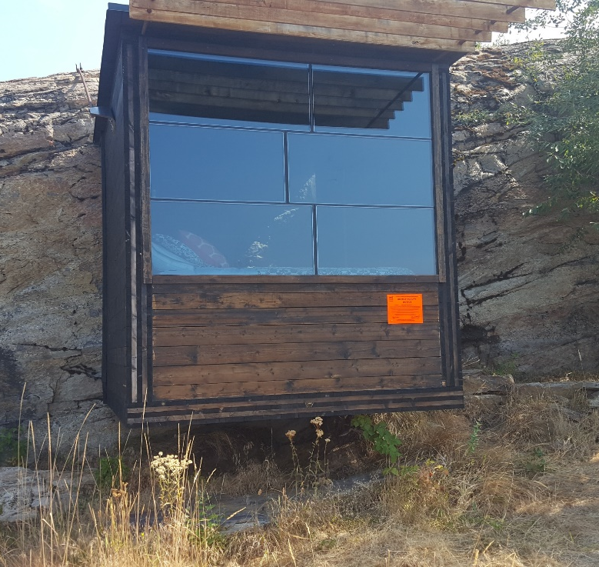
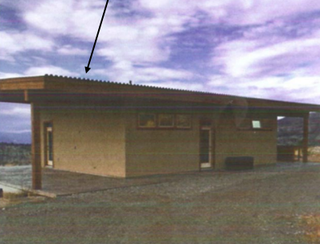
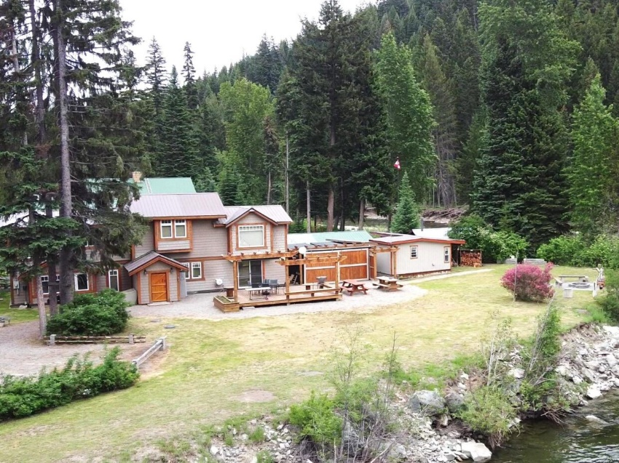
What is not a vacation rental?

Slide 8

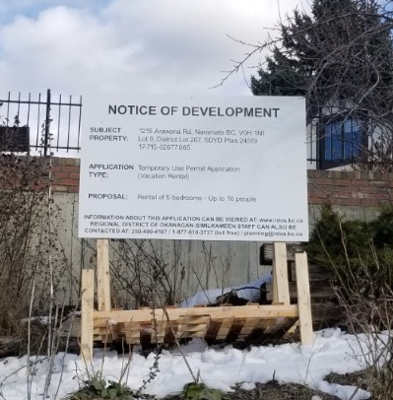




Vacation Rental Processing Procedures
To: Applicant
To: Neighbour
E-MAIL:
Director
External Agencies
www.rdos.bc.ca

Slide 9
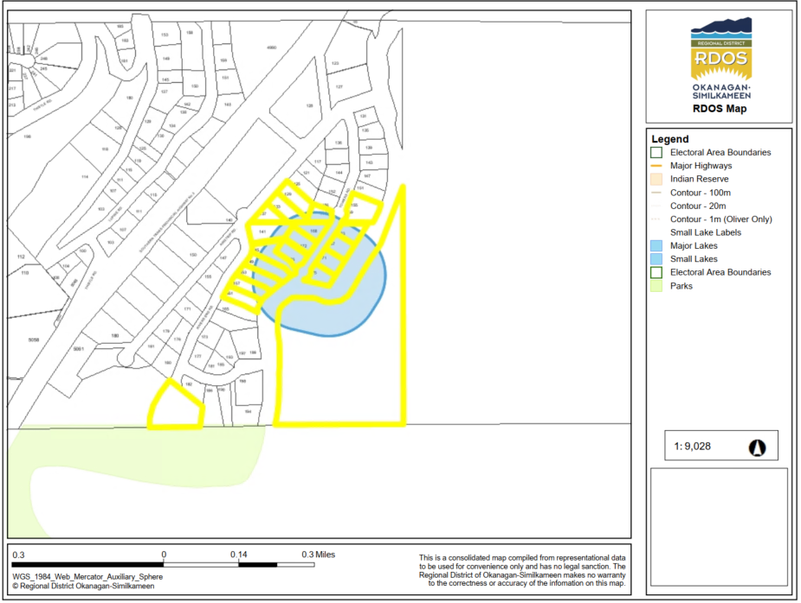
Vacation Rental Processing Procedures
100m mailing radius for Adjacent Letters and VoyentAlert!

Slide 10

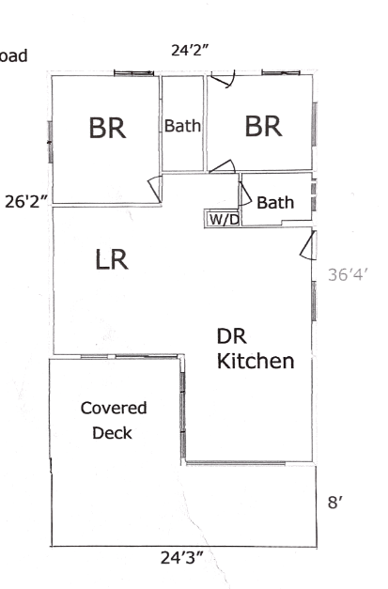
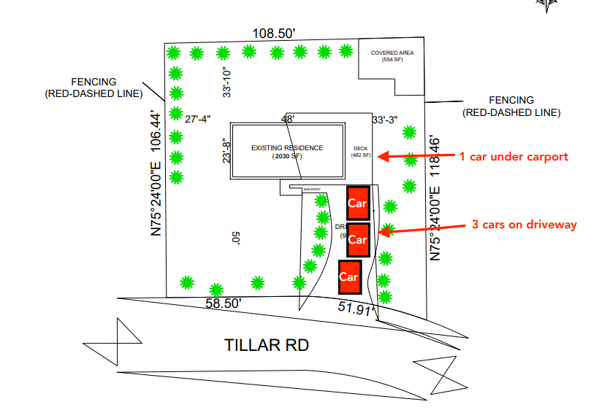

Vacation Rental Processing Procedures

Slide 11
Vacation Rental General Conditions
“One full season” approval;
“Seasonal use”;
Posting of information within vacation rental;​
Maximum occupancy of two (2) people per bedroom;​
One (1) parking stall per bedroom;​
Prohibition of camping or use of RVs or accessory buildings for vacation rental occupancy; ​
Providing property manager contact information to neighbours (100 metre radius).

Slide 12
Vacation Rental Processing Procedures
RDOS Board Consideration:
  Approve;
  Approve with conditions;
  Deny; or
  Refer to APC or PIM.
Notes:
Speak to board follow up and what is provided to neighbours upon approval

Slide 13




Renewal/ Re-issuance Delegated Authority
Can be approved for up to 3 years;
Can be delegated to staff for approval if no:
I do not support….

Slide 14

Bylaw Enforcement
Enforcement:
Complaint driven;
Anonymous complaints are not accepted;
Anyone can submit a land use complaint.
Enforcement Options:
Stop the use
Approve the use through TUP
Modify (if possible) to achieve compliance

Slide 15
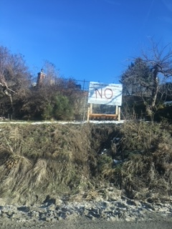

Vacation Rental TUPs
Notification Sign vandalized and garbage dumped on driveway in Area “E”
Petition against Vacation Rentals at Missezula Lake, Area “H”

Slide 16


Vacation Rental Review
Vacation Rental Survey
Vacation Rental RFP

Slide 17


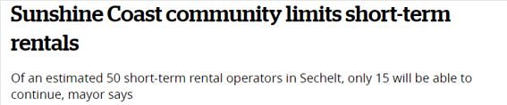

Short Term Rentals in the News
Notes:
Cortes Island

Slide 18

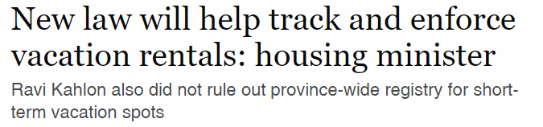
Short Term Rentals in the News
Notes:
A collection of headlines…

Slide 19
Vacation Rental TUPs
QUESTIONS?

