Slide 1
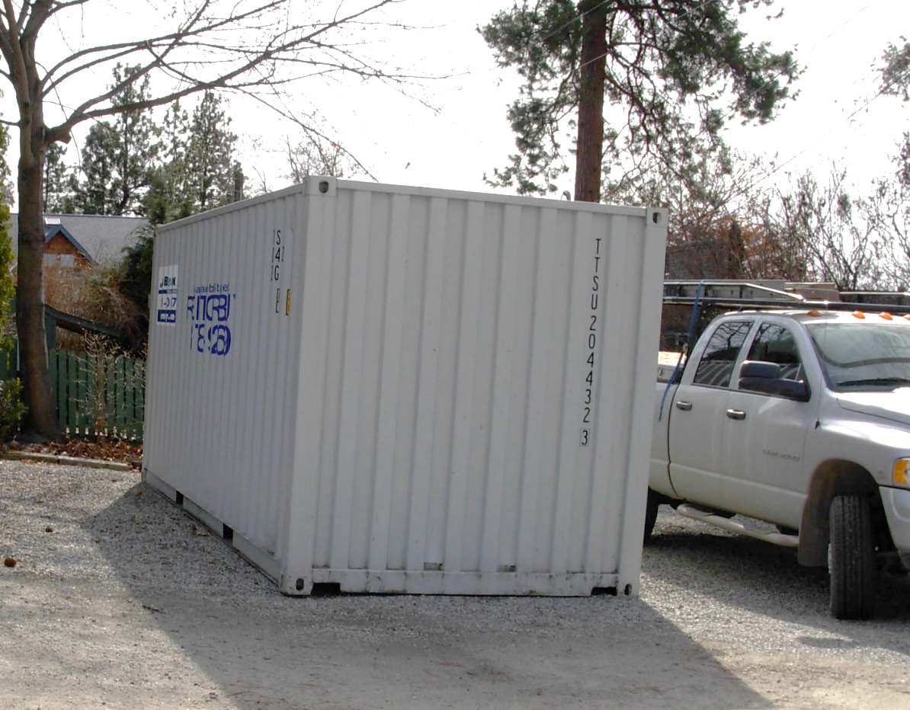
Metal Storage Containers Regulation Review
RDOS File No. X2020.006-ZONE
Public Hearing
May 30, 2022

Slide 2
Metal Storage Containers
Regulatory Overview:
Prior to 2018, the Building Bylaw was silent on metal storage containers and now require a “Siting Permit”;
Zoning Bylaw interpretation is that metal storage containers are a form of “accessory building or structure”:
  permitted in almost all zones;
  must comply with height, setback and coverage zone regulations for “accessory building or structure”.

Slide 3
Metal Storage Containers
Proposed Amendments:
Adding a new definition of “metal storage container”;
In the Resource Area, Agriculture, Large Holdings, and Industrial zones – stacking is restricted to a maximum of 2 containers with a building permit;

Slide 4
Metal Storage Containers
Proposed Amendments:
In the Low Density Residential and Small Holdings zones – limited to the placement of 1 container
  Must not be sited between a principal building and the front parcel line, and in a Low Density Residential zone, an exterior parcel line
Prohibit placement of metal storage containers in the West Bench Low Density Residential zone

Slide 5
Metal Storage Containers
Proposed Amendments:
Allow for the use of 1 metal storage container for temporary storage:
  During construction in any zone, provided that a valid building permit has been issued for that construction; must remove the container upon completion of construction
  For a period not exceeding 30 days for the purpose of loading/unloading related to a relocation of a residential/commercial use.

Slide 6
Metal Storage Containers
Next Steps:
Board consideration of 3rd reading;
Board consideration of adoption of the amendment bylaw

Slide 7
Metal Storage Containers
QUESTIONS?

