Slide 1
Electoral Area “C”
Proposed Zoning Bylaw Amendment
7762 Island Road
RDOS File No. C2022.016-ZONE
Public Information Meeting
December 7, 2022

Slide 2
Public Information Meeting
What is a Public Information Meeting:
It is informal:
  no formal minutes will be taken but meeting is recorded;
  comments for the RDOS Board to review at 1st/2nd reading should be submitted in writing (i.e. email, feedback form).
Staff and the applicant are available to answer questions;
  we may not be able to answer all questions tonight but can follow-up (contact details will be needed).

Slide 3
Webex Instructions
Will take questions in turn;
To indicate you want to speak:
  Computer: click the “Participants” button at the bottom right corner of the screen, hover your mouse next to your name and click the “raise hand” button;
  Phone: press *3 to “raise hand”;
You will be unmuted when it is your turn to speak; and
After you are done, click the “raise hand” button or *3 to take your hand down.

Slide 4
Application Status
Application Status:
Submitted Oct 19, 2022;
Agency Referrals (e.g., ALC, IHA, AFF, etc.) sent Oct 27, 2022;
Public Information Meeting on Dec 7, 2022;
Advisory Planning Commission meeting TBD;
RDOS Board consideration (i.e. 1st/2nd reading) Jan 5, 2023;
Public Hearing (dependent on 1st/2nd reading being approved).

Slide 5
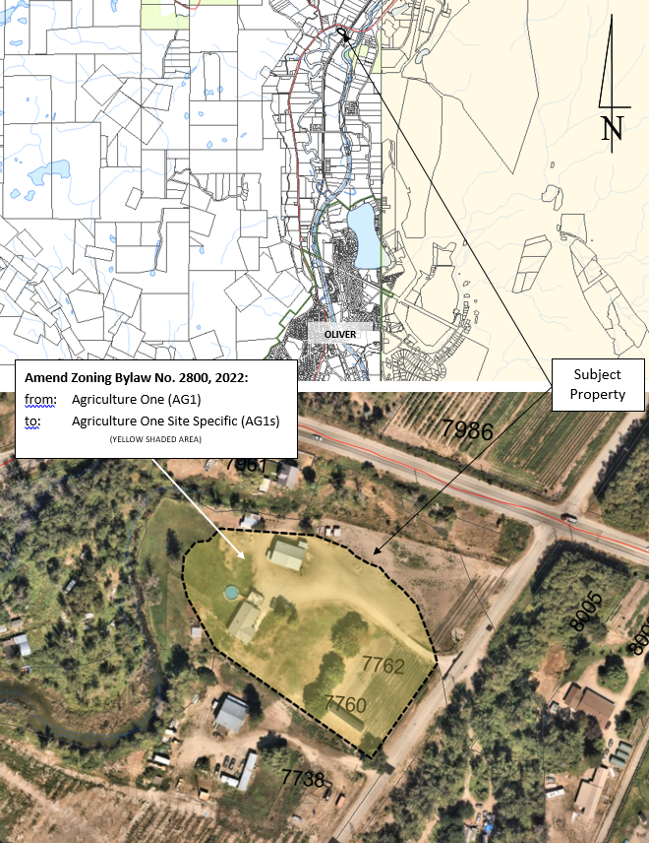
Proposal Details
Location: 7762 Island Road
OCP: Agriculture
Zoning: Agriculture One (AG1)
ALR: Entirely within the ALR
Parcel Size: 1.04 ha
The subject property contains a single detached dwelling, a shop, and the subject mobile home.

Slide 6
Agriculture One (AG1) Zoning
Relevant Permitted Uses:
  Accessory Dwelling, subject to Section 7.2
    Accessory dwellings are only permitted on parcels of 1.0 ha or greater, if it is not connected to a community sewer system
    A maximum of one principal dwelling unit and one accessory dwelling to a maximum floor area of 125 sq m if permitted on parcels less than 8.0 ha in size
    An accessory dwelling is permitted in the form of a mobile home only on parcels 4.0 ha or greater

Slide 7
ALR Regulations
Despite the Regional District’s zoning provisions, the proposal must remain consistent with s. 34.3 of the Agricultural Land Reserve Use Regulation:
  If the parcel is 40 ha or less, there will be:
    One residence, the total floor area of which is 500 sq m or less, and
    One residence, the total floor area of which is 90 sq m or less
The subject mobile home has a floor area of approximately 74.6 sq m

Slide 8
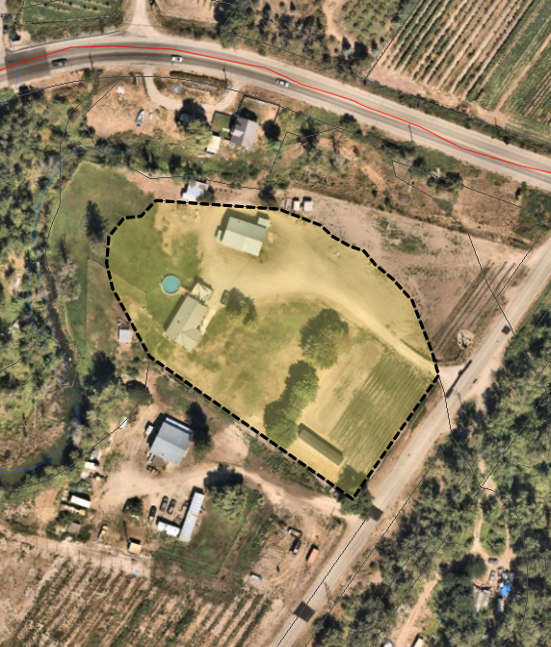
Proposal Details
Proposed Amendment: to amend the Okanagan Valley Zoning Bylaw No. 2800, 2022:
  From: Agriculture One (AG1)
  To: Agriculture One Site Specific (AG1s)
Purpose: to allow the applicant to retain a mobile home on the parcel, which is less than 4 ha in size.

Slide 9
QUESTIONS?
If you do not get the chance to speak tonight, have more questions, or would like to submit written comments, please contact me at:
sduong@rdos.bc.ca
(250)490-4384

