Slide 1
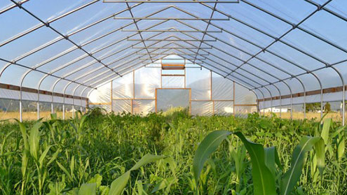
Essential Nutrients Urban Farms
Re-imagining sustainable agriculture in the North, through the use of season extension technology under high tunnels in order to create year-round horticultural production of high value vegetable and fruit crops!

Slide 2
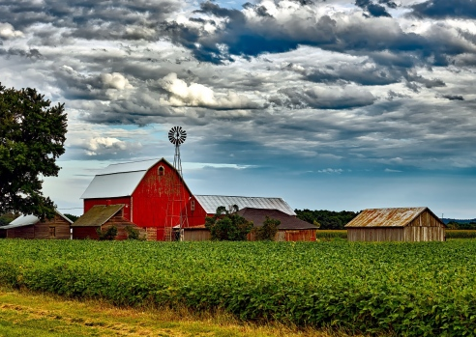
Promote Growth
Part 1:
Introduction to Canada’s Food Self-Reliance Concerns
Part 2:
Examining South Korea’s Year-Round Food Production Using High Tunnels
Part 3:
Creating A New Farming Culture in Canada

Slide 3
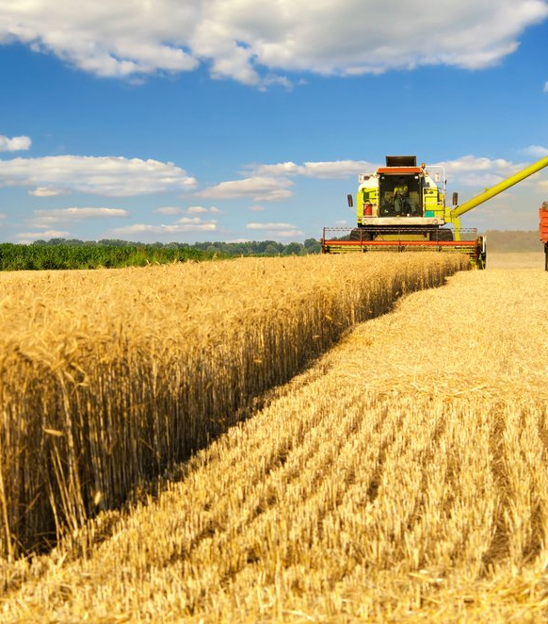
Local Based Food Challenges in Canada
Canada is less than 40% food self-reliant
Canada imported approximately $3.7 billion in vegetables in 2017 (field vegetables, greenhouse vegetables, and mushrooms)
Canada imported approximately $11.3 billion in fresh and processed fruits in 2019
Average Age of Farm Operators in Canada is 55
Younger farmers lack financing while land continues to increase in price

Slide 4
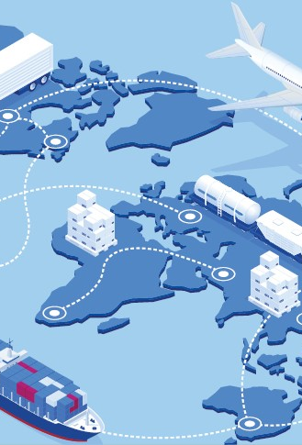
Rising Food Prices, Global Supply Chain, Attack on Farmers
Global Supply Chain Instability Along With Future Crop Losses (Grand Solar Minimum) Will Lead to Food Shortages and increased Global Food Insecurity
Global Food Prices Have Increased 38% Since January 2020 – World Bank
Japan bans export of seeds!
Argentina, Bolivia bans export of beef
Operations have run out of feed for animals, expect meat shortages
Climate change NOW causing record cold temperatures across the globe, crop failures.

Slide 5
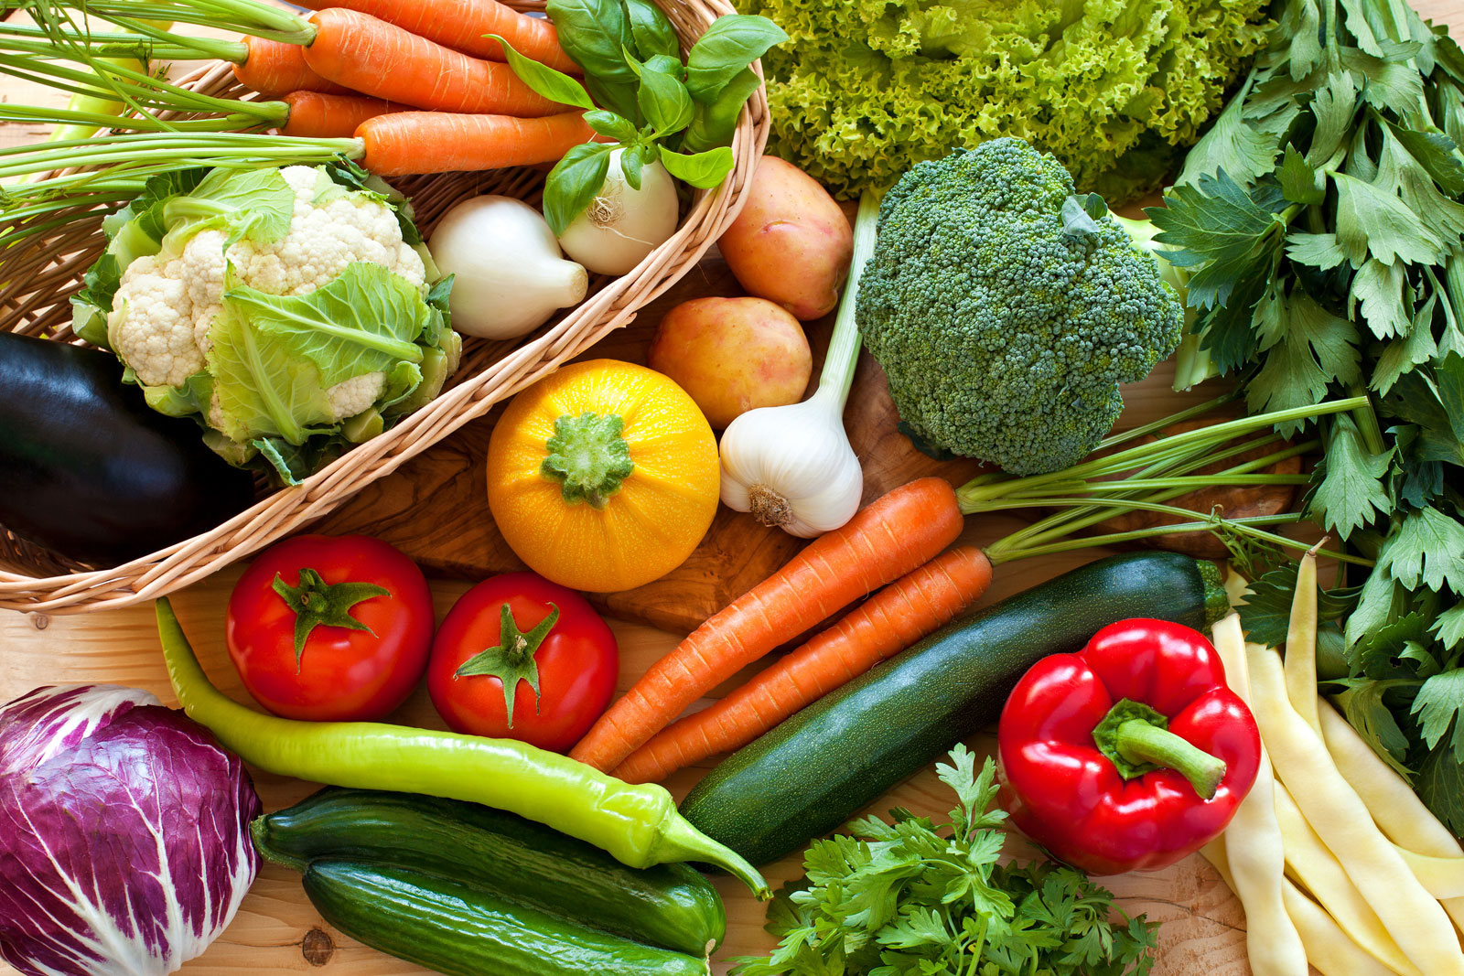
Food Self-Sufficiency
Food self-sufficiency means that a country produces enough food to feed all its people without having to import food from other countries.
Newfoundland & Labrador have a 2022 goal to DOUBLE food self-reliance for the province to 20%.
New Brunswick - Overall self-sufficiency in fruit is 32% and self-sufficiency in vegetables (excluding potatoes) is approximately 7%.
In 2011, Southwest BC total food self-reliance reached 40%.
Nova Scotia - The Government shall SET A GOAL to procure 30% of its food requirements from local producers by the year 2026.

Slide 6
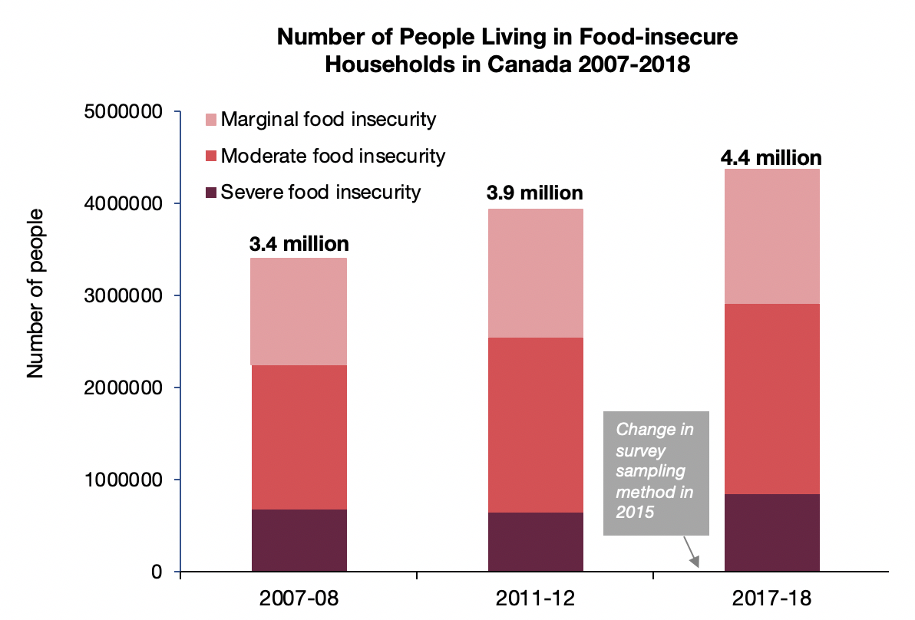
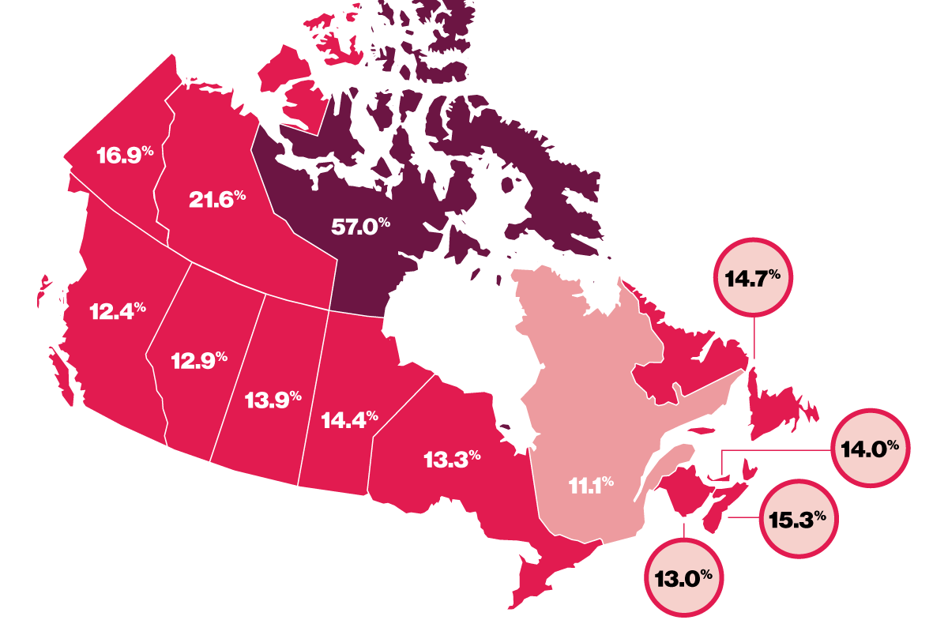
Food Insecurity:
A look a food insecurity in Canadian households
Food insecurity has many causes none more linked than job opportunities and income as 65% of food insecure households are in the workforce.
Almost 60% of people on disability, social assistance, or senior incomes are food insecure.
Food insecurity takes a tremendous toll on people’s health and the healthcare system. – Food Insecurity Policy Research
Marginal food insecurity: Worry about running out of food and/or limited food selection due to a lack of money for food.
Moderate food insecurity: Compromise in quality and/or quantity of food due to a lack of money for food.
Severe food insecurity: Miss meals, reduce food intake, and at the most extreme go day(s) without food.

Slide 7
Food miles is the distance food is transported from the time of its making until it reaches the consumer.
Food Miles!
How old is your food?
Common foods like potatoes, apples, carrots, tomatoes, kiwis, bananas, lettuces are often weeks old by the time they are purchased and sometimes months old.
Most food loses 30-50% of its nutrition before it even reaches the store shelves.
How much of your food is bad by the time you buy it from the supermarket? Would less food be wasted if the food was actually fresh at the time of purchase?

Slide 8
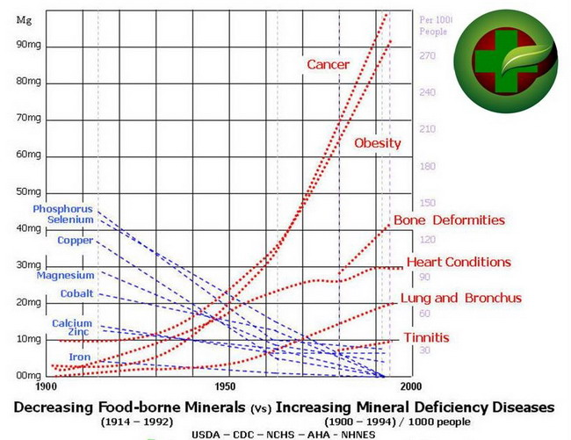
Mineral Soil Depletion
“The alarming fact is that foods, fruits and vegetables and grains, now being raised on millions of acres of land that no longer contain enough of certain needed minerals, are starving us – no matter how much of them we eat!” – US Senate Document 264 in 1936.
It was found that most soils were deficient in mineral nutrition in 1936! What does that mean for the soils of today? Not all farms are the same, minerals are not evenly spread out from farm to farm. If you are farming on virgin soils and have a generous foundation of minerals, you might have a good ratio to create beneficial foods. However, if your farmer has been turning over crop after crop on the same parcel of land for 10, 20, or more years; does your produce have any mineral nutrition?
If its not in your soil its not in your food!

Slide 9
Why is Mineral Nutrition Important?
Two-time Nobel Prize winner, Dr. Linus Pauling, stated “You can trace every sickness, every disease and every ailment to a mineral deficiency.” “There are 75 metals listed in the periodic chart, all of which have been detected in human blood and other body fluids – we know that at least 60 of these metals (minerals) have physiological value for man”. – Dr. Linus Pauling
Organically not a single function in the human body can take place without at least one mineral or metal cofactor”. – Dr. Wallach
According to Dr. Joel Wallach, DVM, ND, a bio-medical research pioneer; there are 90 essential nutrients. 60 minerals, 16 vitamins, 12 amino acids, and 2 essential fatty acids. Minerals are in fact required by all body functions from the basic subcellular molecular biological “metallic fingers” of RNA and DNA to electro-chemical, catalytic, structural, reproduction, maintenance, repair and a plethora of miscellaneous functions. – Dr. Joel Wallach – Rare Earths: Forbidden Cures, 1994.
Our goal as a farmer is to provide our plants with the necessary building blocks to help them grow to their fullest potential. We know that plants require much of the same nutrition that humans do and when we add minerals to our plants, they will grow stronger, producing a wider array of phytochemicals and polyphenols that contribute to health promotion and disease prevention.
There is a clear lack of understanding in modern farming practices that is producing foods that are deficient in nutrition. This is the “missing link” that nobody in farming, health, and food is talking about. There must be a real effort to start amending soils with organic minerals to produce foods that are optimized for the human body.

Slide 10
“Our Sun has begun a 30-year cycle of decreased activity termed a Grand Solar Minimum and known by it's more common effect "Global Cooling". From 2016 forward, global temperatures will cool 1.5 - 3C which will have a dramatic impact on weather patterns and global food production” - https://www.oilseedcrops.org/global-cooling/
British Astrophysicist: “Mini Ice Age is Accelerating – New ‘Maunder Minimum’ Has Begun”, Sept. 23, 2020 “We are plunging now into a deep mini-ice age,” says British astrophysicist Piers Corbyn, “and there is no way out”.
“For the next 20 years it’s going to get colder and colder, on average, says Corbyn who holds a B.Sc. in Physics and an M.Sc. in Astrophysics. The jet stream will be wilder: there will be more wild temperature changes, more hail events, more earthquakes, more extreme volcano events, more snow in winters, lousy summers, late springs, short autumns, and more and more crop failures. - https://electroverse.net/british-astrophysicists-mini-ice-age-is-accelerating-new-maunder-minimum-has-begun/
“The Sun has entered into the modern Grand Solar Minimum (2020–2053) that will lead to a significant reduction of solar magnetic field and activity like during Maunder minimum leading to noticeable reduction of terrestrial temperature” –https://www.ncbi.nlm.nih.gov/pmc/articles/PMC7575229/
Grand Solar Minimum

Slide 11
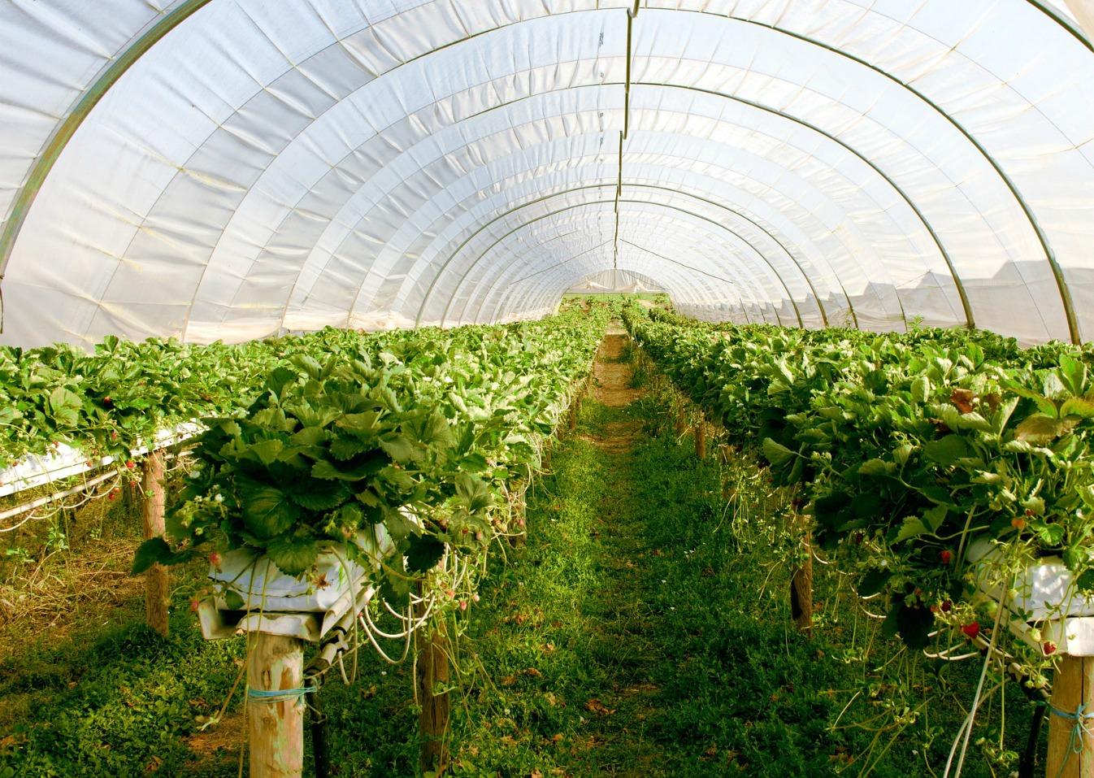
Part 2:
Examining South Korea’s Year-Round Food Production Using High Tunnels

Slide 12
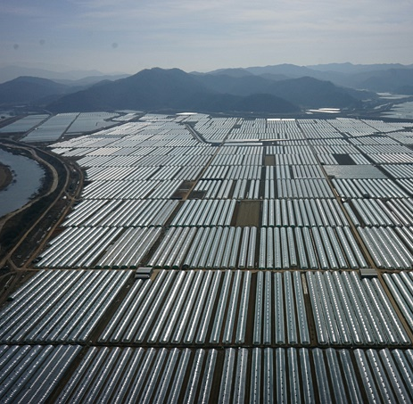
South Korea’s White Revolution of Agriculture
Overview – “White Revolution” refers to the promulgation of high tunnels and and the extensive use of plastics using polyethylene film to create the year-round production of horticultural products for FOOD SELF-SUFFICIENCY.
After the Korean War ended in 1953, South Korea was a donor country receiving food through foreign aid as Japan subverted much of Korea’s grain supply for its military.
During the 1960s, the Korean government set up the National Economic Development Plan and food self-sufficiency was the primary focus.
100% Rice self-sufficiency was reached in 1975.
Over the next 20 years, South Korea expanded its High Tunnel and Greenhouse production capacity which enabled year-round production of horticultural products.
Protected agriculture (high tunnels) expanded from 6,600ha in 1975 to 81,600ha in 1995.

Slide 13
Protected Horticulture: South Korea vs. Canada
South Korea |  |  | Canada
Population | 51.71 million (2019) |  | Population | 37.59 million (2019)
Vegetable production | 9,904,000 tons (2014) |  | Vegetable production | 2,813,000 tons (2017)
Open Field Production | 7,190,000 tons (2014) |  | Open Field Production | 2,178,558 tons (2017)
Protected Horticulture | 2,175,000 tons (2014) |  | Protected Horticulture | 634,000 tons (2017)
Open Field Horticulture | 182,910 ha (2014) |  | Open Field Horticulture | 103,669 ha (2017)
Protected Horticulture | 83,629 ha (2016) |  | Protected Horticulture | 16,882 ha (2017)
Total Farmers | 1,537,608 (2014) |  | Total Farmers | 278,000 (2017)
Avg Farm Size | 1.4 ha (2005) |  | Avg Farm Size | 323 ha (2020)
Arable Land | 1,421,000 ha (2018) |  | Arable Land British Columbia | 4,600,000 ha (2018)

Slide 14
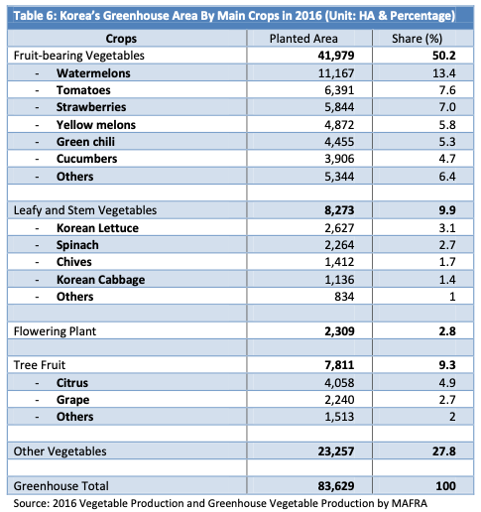
South Korea’s High Tunnel Production Crops 2016
Protected horticulture is quite extensive in South Korea and includes a wide variety of fruits, vegetables, flowering plants and even tree fruits.
In Canada, 96% of all greenhouse growing operations produce only tomatoes, bell peppers, and cucumbers. (17k ha)
Almost none of these greenhouses are high tunnels and most of the crops are considered high value and are exported to the US
All other Canadian grown crops are grown in open field production or are imported from the US and Mexico to meet year-round needs.

Slide 15
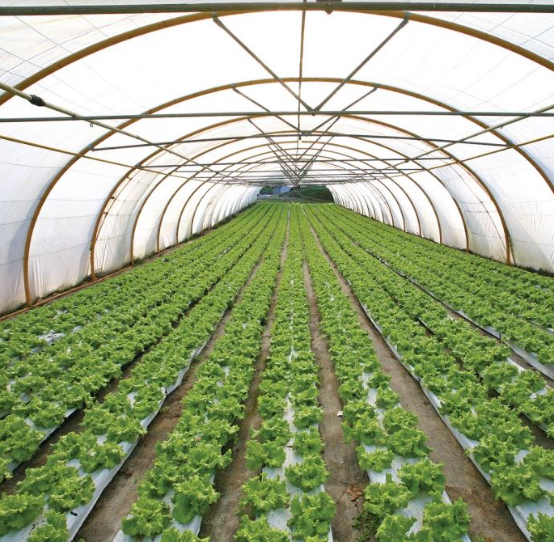
High Tunnels and Protected Farming
An enclosed polyethylene, polycarbonate, plastic, or fabric covered structure that is used to cover and protect crops from sun, wind, excessive rainfall, or cold, to extend the growing season in an environmentally safe manner.
High Tunnels, polytunnels, low tunnels, and greenhouses are common protective agricultural structures that can be used to improve growing conditions over open-field cultivation. Protected agriculture has many benefits including:
Healthier yields, longer seasons
Ability to grow crops all-year round
Ability to cycle crops 2-3 times
Ability to grow certain warm weather crops
Save on H2O, Pesticides and other inputs
Reduce incidences of crop damage
Cost effective, ROI < 1 Year

Slide 16
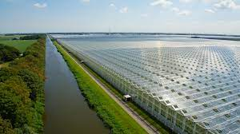
Are Large Scale Greenhouses Necessary?
Industrial scale greenhouses are a massive undertaking in terms of construction and mechanization required. In Canada’s current economic landscape, the costs of year-round operation of Venlo climate-controlled greenhouses have gone through the roof with increased carbon taxes, insurance costs, minimum wage increases, natural gas and hydro rates.
South Korea has less than 1% of their protected cultivation under glass greenhouses.

Slide 17
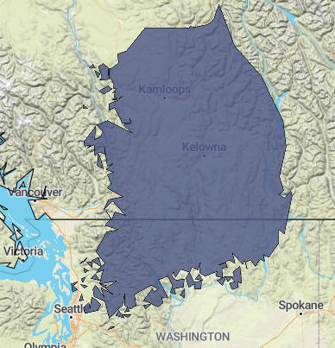
Arable Land?
ALR Land 4.6 million hectares of Arable land in British Columbia
CROWN land
Young Agrarians Land Matching Program
Reclaiming underutilized farms and lands
In British Columbia, we are blessed with more than 3x the arable land of South Korea. See image of the size of South Korea fitting inside the Thompson Okanagan interior regions. There is an abundance of arable land, water resources, and geo-thermal heat to house thousands of acres of high tunnels, greenhouses, and other protected agriculture structures to support local and regional communities.

Slide 18
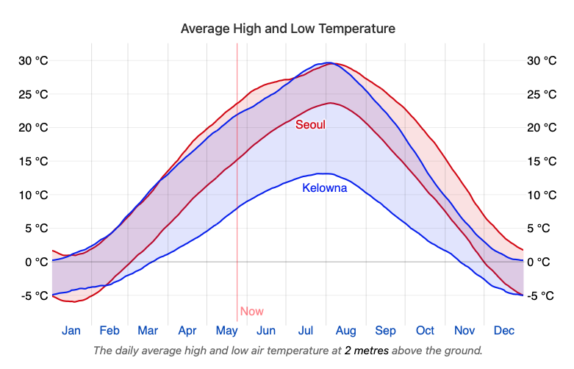
South Korea vs. Okanagan Climate Comparison
Despite being thousands of miles away on two separate continents, the average temperatures throughout the year are quite similar.
South Korea tends to have rain in the summers and dryer winters.
The Okanagan tends to have rain in the winters and dryer summers.

Slide 19
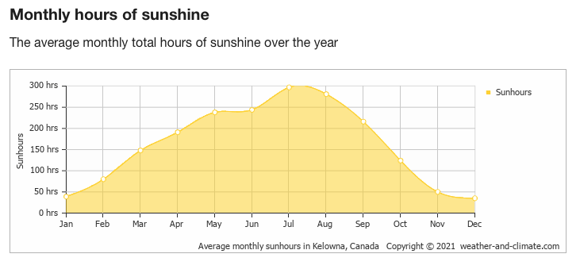
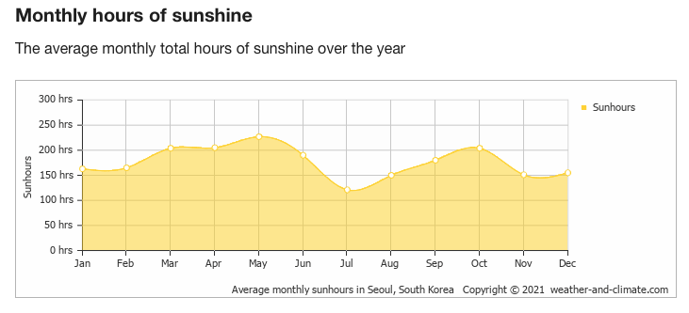
Kelowna
Sunlight Comparison
Working towards year-round production in Western Canada shows that November, December, and January have significant lows in monthly hours of sunlight. These months may require supplemental lighting in order to have winter crops flourish under cover during these cloud covered months.
Due to the higher latitude in Canada, most crop growing areas have 1.5 hours less of light per day during the winter solstice and consequently 1.5 hours more sunlight during the summer solstice.
Seoul

Slide 20
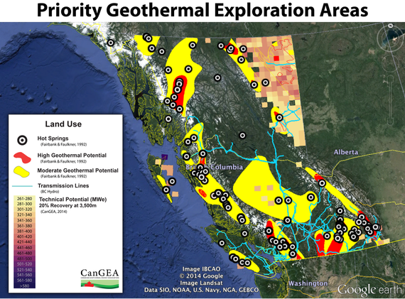
Geothermal Heat?
Canada has an abundance of natural resources to support heating crops throughout the winter. Cheap natural gas, electrical heat, and possibly geothermal heating may provide the necessary heating requirements during the coldest months of the year.
Underground heat transfer uses PVC pipe and Clay pipes at 50cm and 80 cm underground to recover some of the heat that gets transferred to the earth under the high tunnel. During the Spring and Fall seasons, this heat transfer technology could help keep the temperatures from falling off during the colder hours of the night.

Slide 21
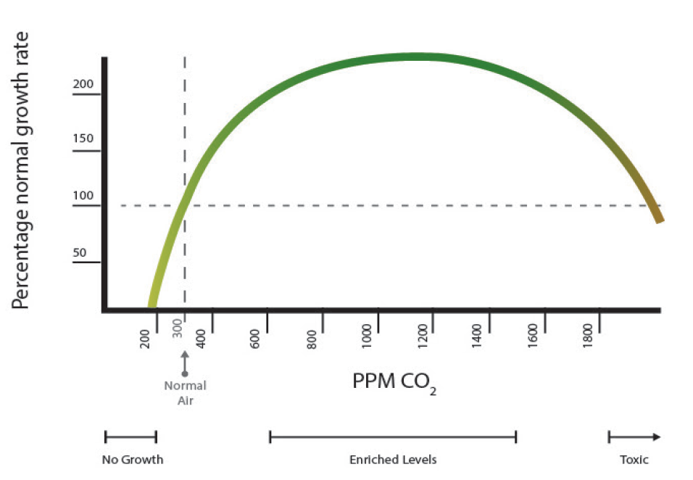
CO2 Supply Technology
It’s a Plant NUTRIENT
CO2 is critical for crop growth and improving crop yields. The closed system of the high tunnel allows for additional supply of CO2 which is beneficial in many ways including:
Increase in photosynthesis, growth rates, and biomass production
Decreased harvest times
Increased transpiration which increases water use efficiency
Supplying 1,500ppm of CO₂ increases the yield of lettuces and spinaches by 150% and 177%, respectively, compared to controls.

Slide 22
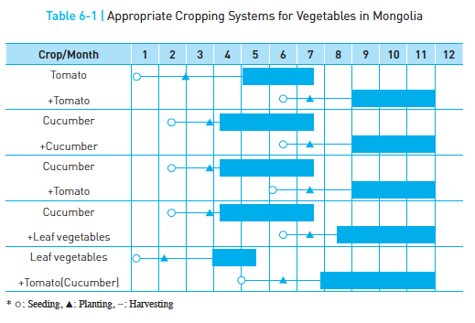
Cold Canada! Production in Northern Canada under High Tunnels
Growing in the northern parts of Canada, the Prairies and Eastern Canada will present tougher growing conditions like Mongolia. With supplemental heating for the late winter, early spring, and fall seasons; two rounds of crop cycles of tomatoes and cucumbers are possible.
Production harvests can provide 6 to 8 months of fresh local produce each season.

Slide 23
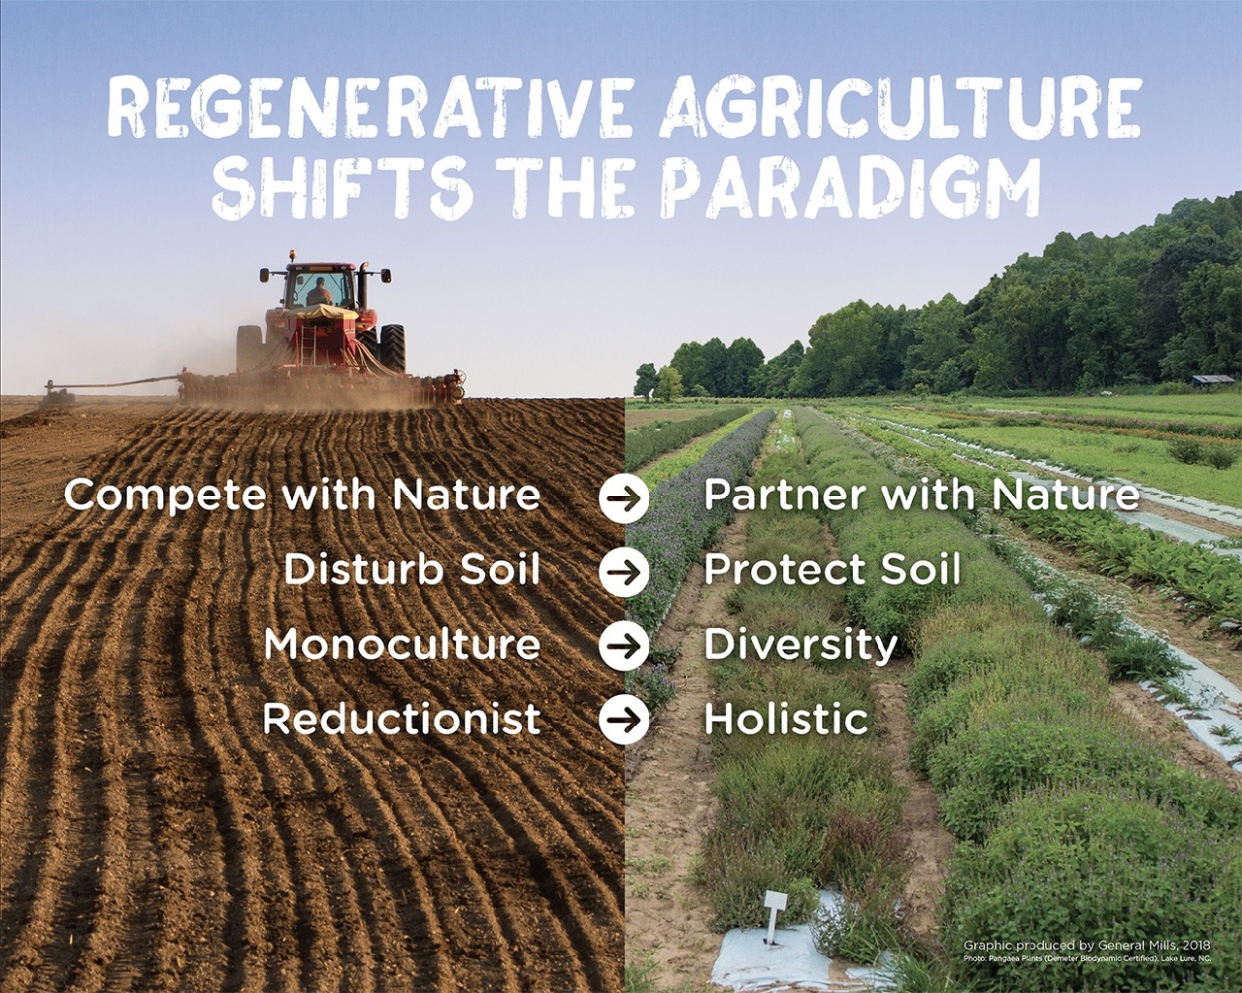
Soil Quality
Regenerative Agriculture Principles
No-Till Agriculture and Reduced Soil Disturbances
Keep the Soil Covered
Keep Living Roots in the Soil
Diversify the Crops
Integrate Animals Back into the System
Korean Natural Farming Principles
Use Nutrients in the Seeds
Use indigenous microorganisms (IMO’s)
Using Fewer Inputs to Maximize Inborn Potential
Avoid Commercial Fertilizers and Pesticides
NO Till, NO Livestock Waste
Think Organic, Non-GMO, High Yields, More Nutrition, Lower Costs to Farmers!

Slide 24
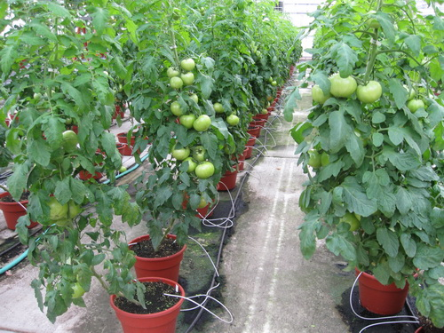
Fruiting Crops
Fruiting crops such tomatoes, cucumbers, peppers, strawberries, and watermelons are almost exclusively grown under protected cultivation methods.
Controlled environments work well with most fruiting crop varieties producing higher yields, earlier harvests and less spoilage come harvest time.
Fruiting crops can often be cropped and harvested twice per season. With supplemental heat and lighting, these crops can be grown year-round in the more temperate southern regions of BC and Ontario.

Slide 25
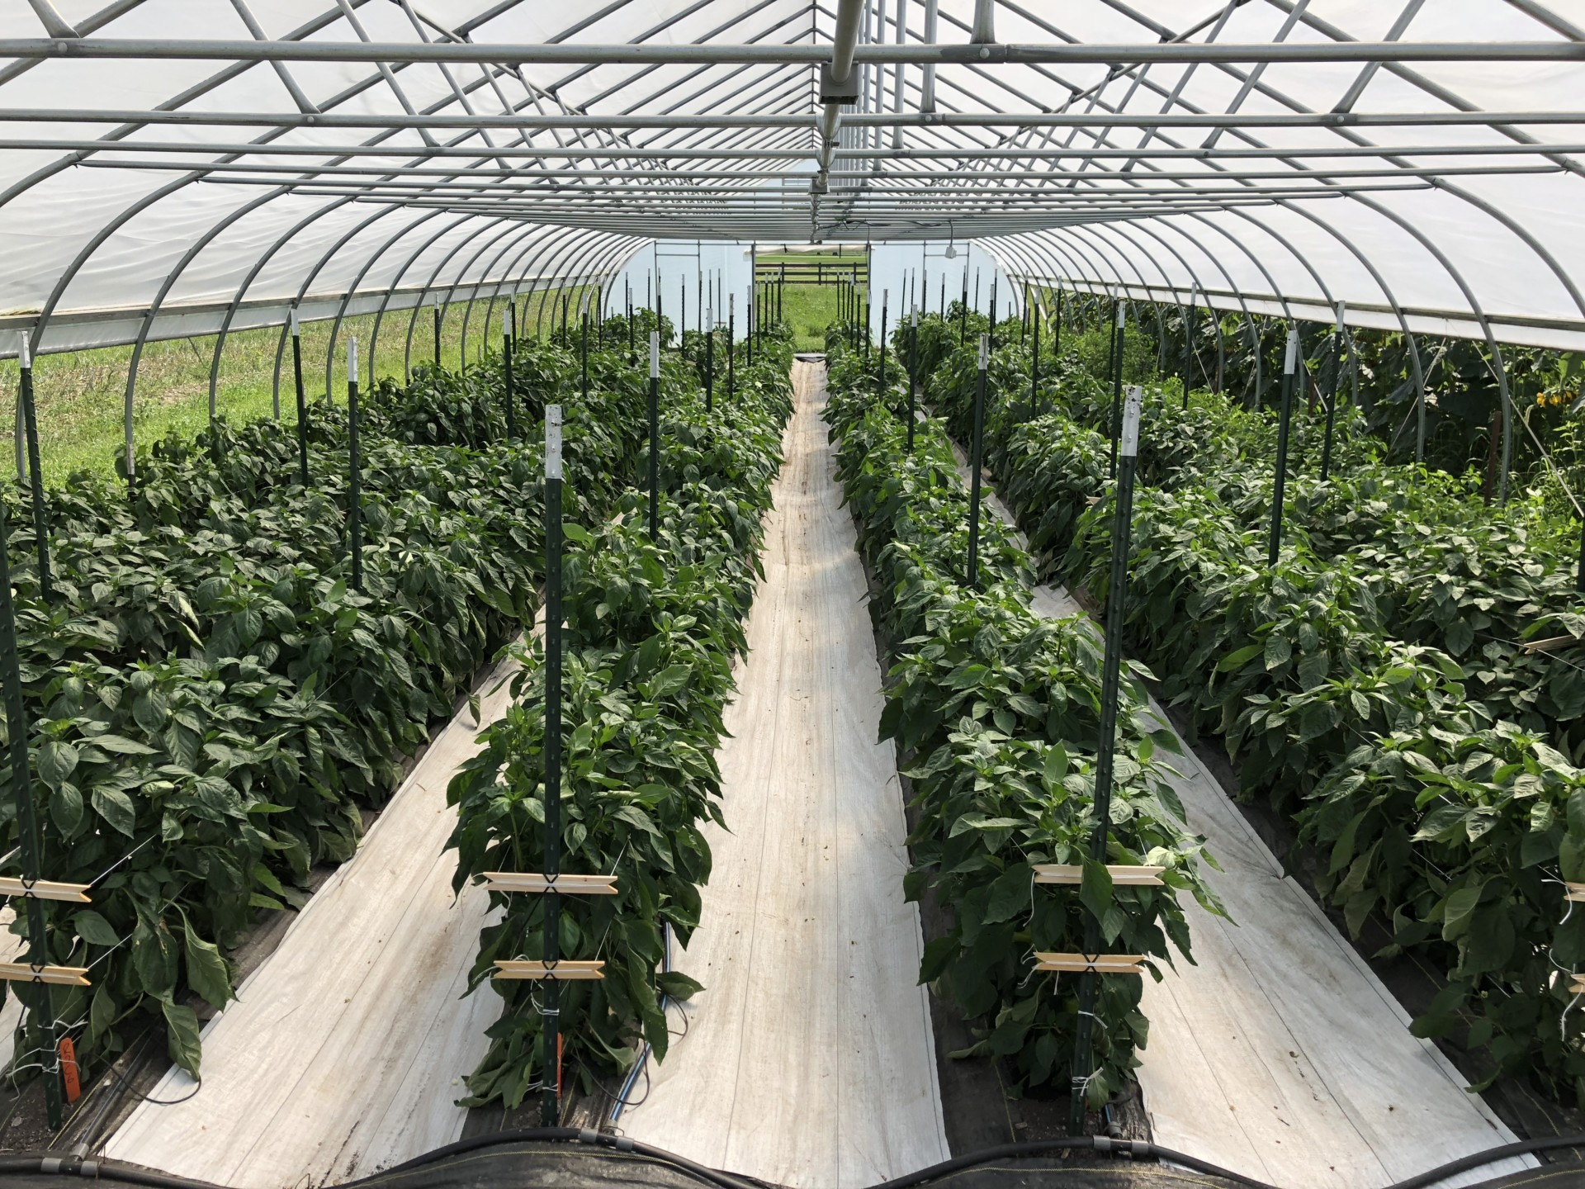
Vegetable Crops
Almost every crop can be grown better under protected cultivation. With season extension technology, many vegetable crops can be grown effectively throughout the winter providing early season harvests.
Lettuces, Kale, Spinach, Cabbages, Broccoli, Carrots, Beets, Radishes, Onions, Green Onions, and a variety of herbs could easily be grown in high tunnels during the spring, fall and winter months supplying year-round production for local grocery stores.

Slide 26
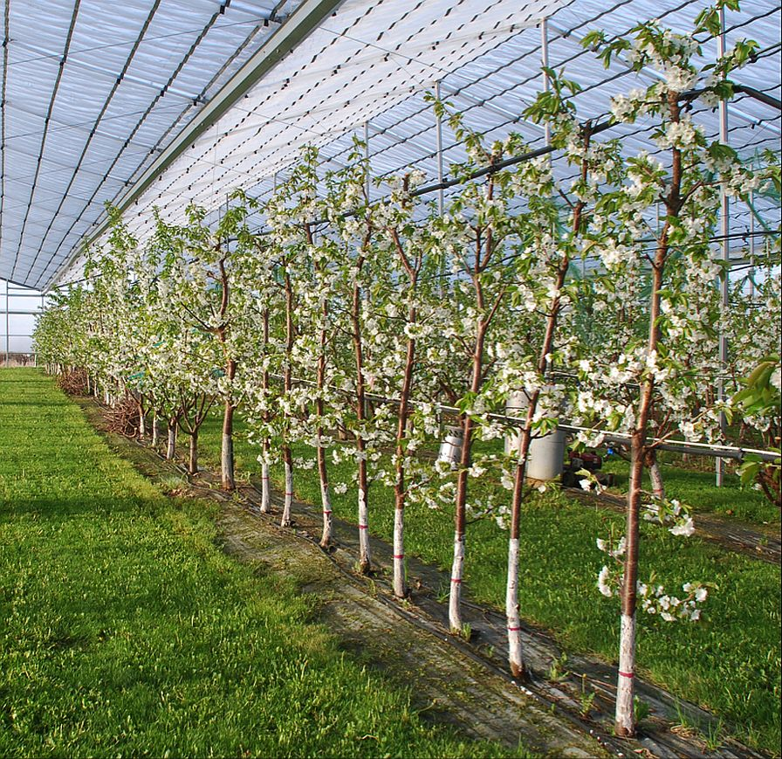
Tree Crops
Citrus fruits, Tropical fruits, and Tree nuts could be successfully grown in Canada if the proper protected cultivation methods were used.
Imagine having Canadian grown Lemons, Limes, Tangerines, Persimmons, Kumquat, Avocados, Guava, Papaya, Dates, Figs, Moringa, Pomegranate, Grapes, etc.

Slide 27
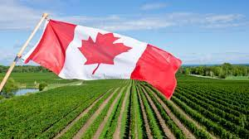
Part 3
Creating a New Farming Culture In Canada
Why we need to support a Canada First Policy in farming?
Food Self-Sufficiency
Food Self-Reliance
Local Based Food Production
Local Based Value-Added Products
Food Based Industrial Growth and Economic Prosperity

Slide 28
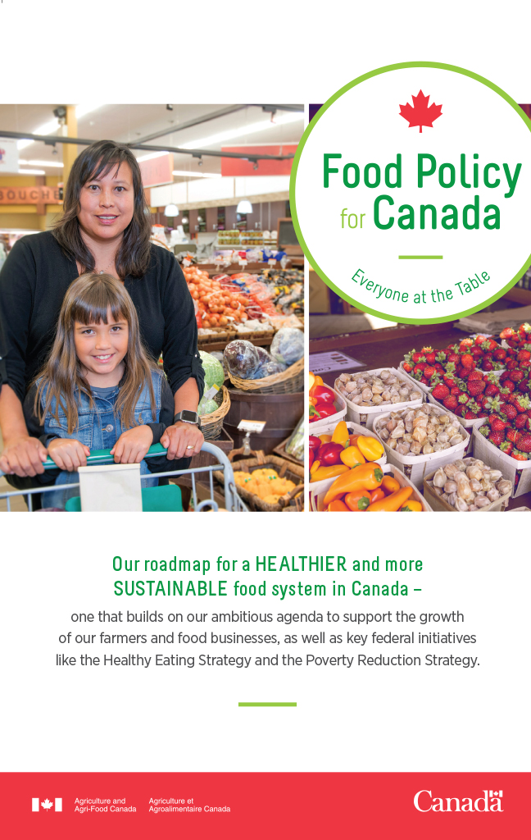
Canada First! Food Policy
Food Policy in Canada is based around 4 Pillars:
Food Security - increasing access to food
Improving Health and Food Safety
Conserving Soil, Water, and Air
Growing More High-Quality Food
Protected Agriculture provides the answer to all these Food Policy Pillars. Growing more high-quality food in Canada for Canadians ensures we are eating the freshest foods, grown in Canadian fields under our watch. High Tunnel growing technology is extremely effective at conserving soil, conserving water, limiting pesticides, and makes crop rotation easier.

Slide 29
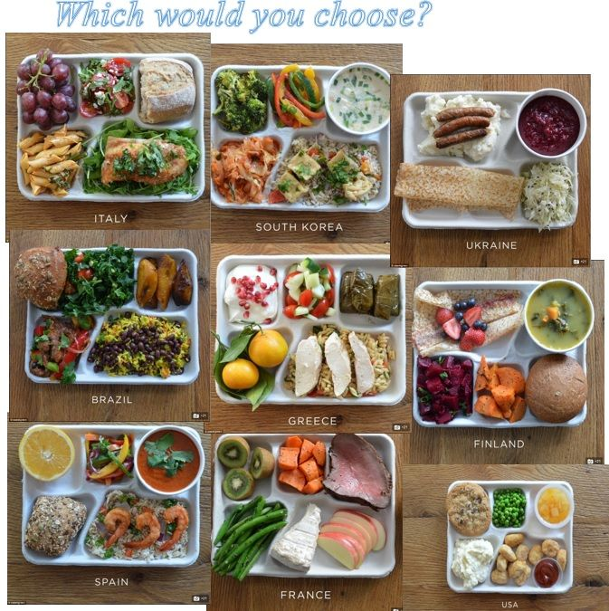
National Healthy Food School Program
Canada remains one of the few industrialized countries without a national school food program. - foodsecurecanada.org
In South Korea, the rate of schools serving school meals reached 100% as of 2013, and 99.6% students eat a school meal each school day. Nutrition teachers were assigned to schools from 2007, and 4,704 (47.9%) nutrition teachers of all nutrition employees were employed in schools as of 2013.
Imagine what could be accomplished if we grew most of our food requirements in Canada.

Slide 30
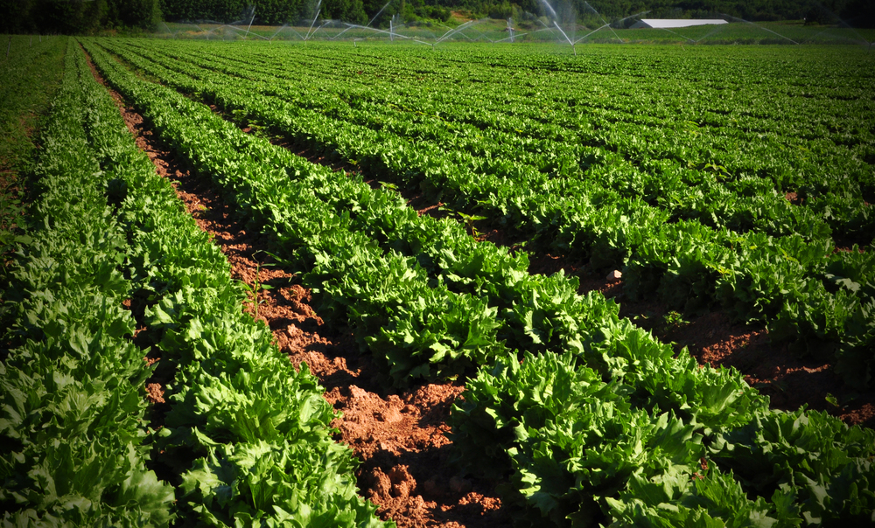
Year-Round Farmers
Traditional vegetable and fruit farming in Canada runs from May to October, which requires many seasonal (60k per season) labourers from out of Country.
High Tunnel production is the most cost-effective way to bring year-round income to seasonal farmers
Year-round farms means year-round jobs. Seasonal work is not appealing to young Canadian workers who have year-round bills.

Slide 31
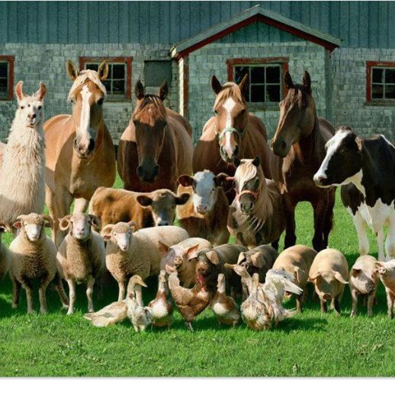
Family Farming
Family farming is the backbone of farming around the world. In Canada, family farming has been declining every year as companies take over larger swaths of land and older generation family farmers look to exit farming.
Women represent 51% of farmers in South Korea and only 27% in Canada.
Opening up small parcels of farmland (1 acre, 2 acres, and more) to family’s willing to work the land should be a priority for provincial and municipal governments.

Slide 32
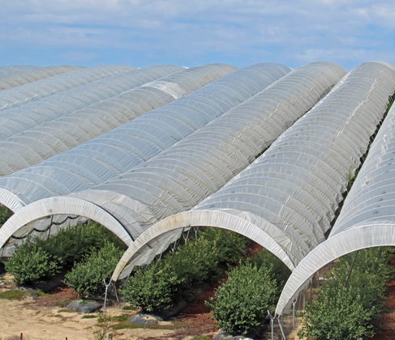
Farming Education
In South Korea, the Rural Development Association created winter programs for farmers and community leaders to help support and educate them about new farm technology and growing techniques.
12 million farmers attended winter programs from 1976 – 1995.
Creating educational programs for farmers in Canada would make farming more accessible for non-traditional farmers.

Slide 33
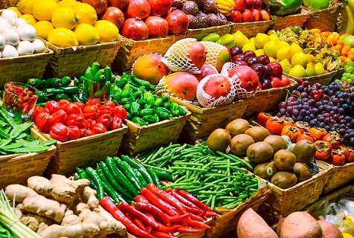
Currently, agriculture only provides 1.5% of the jobs in Canada while barely supplying enough food for 30% of the population.
With over 36 billion in food imports each year in Canada, protected agriculture can provide jobs in food production and value-added food products.
The USDA National Resource Conservation Service has a subsidy program called the High Tunnel System Initiative to help farmers implement season extension High Tunnels to conserve resources.
Canada has no such program.
Industry and Jobs

Slide 34
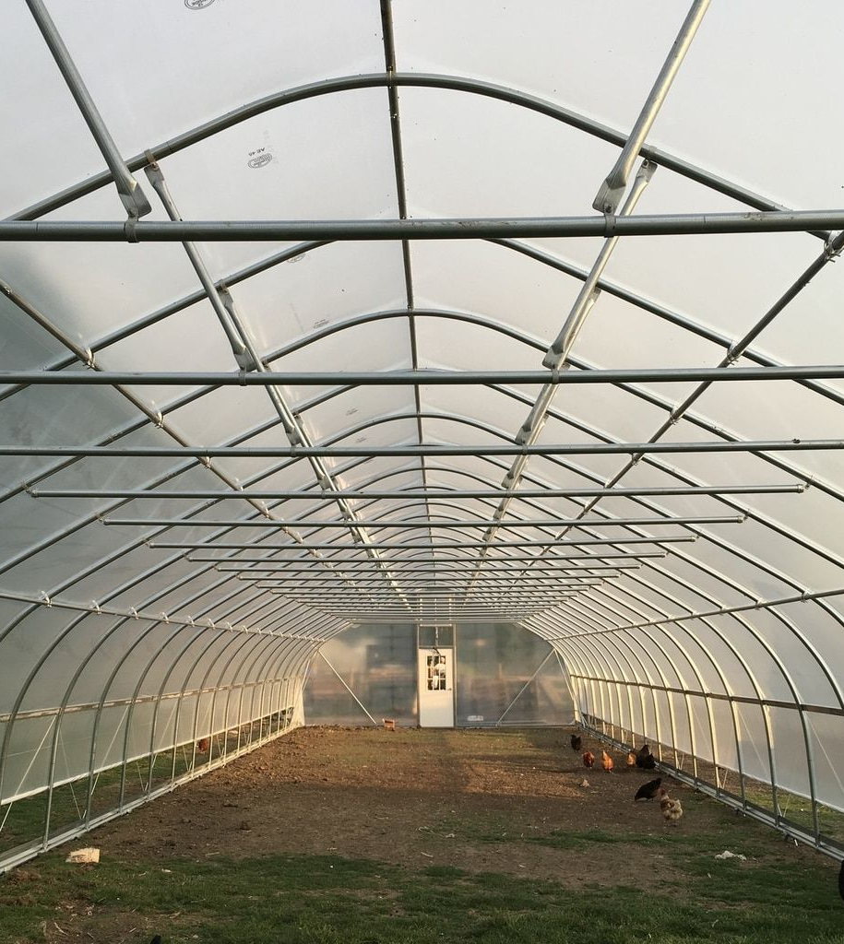
High Tunnel Construction Materials
Greenhouse and high tunnel construction materials could be produced and manufactured in Canada. These items include Iron Pipes, Agricultural Plastics, High Tunnel Accessories, Irrigation, Lighting, Heating, Geothermal Technology, Agriculture Nutrients, Soil Amendments, Small Farm Equipment, and Automation, etc.
In 2010, South Korea produced 110 million tons of Steel Pipe for agriculture productions.

Slide 35
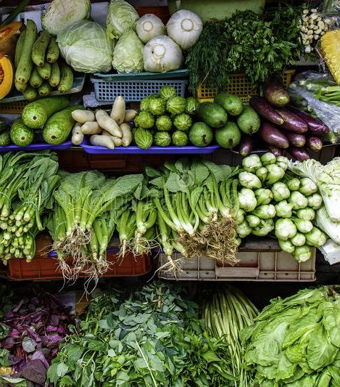
Canada First!
Food Self-Reliance
Centrally located food hubs with cold storage, processing, and distribution can aggregate food and market products to local grocery stores, ensuring a steady flow of locally grown produce.
Crops and cropping systems can be managed by a cooperative groups of farmers and joint greenhouse management teams. Shipments and sales should be coordinated as well.
Bring back Agri-Culture to our communities!

Slide 36
Help us grow farming! info@kelownamicrogreens.ca
778-214-8568
Summary:
Creating a self-reliant food system in Canada should be part of our strategic National Security Plan. The global marketplace is fraught with issues and food security concerns have been mounting. If in fact a weakened or dormant sun is here (Grand Solar Minimum), Canada is at a massive disadvantage to countries who have built food production systems under protected cultivation methods. High tunnels are best way for young farmers to build farm wealth and food self-sufficiency for Canadians.
How can you help? We are looking for farming stakeholders to assist in building a self-reliant food model that will work for Canadians. If you are a Landowner, Investor, Farmer, Grocery Store, Local Food Market, Municipal, Provincial, and Federal Politician, Farming Stakeholder, Agricultural Land Commission, First Nation’s Stakeholder, etc., please reach out to your local leaders to put protected cultivation on the map.
If the US and Mexico can subsidize farmers to build high tunnels, we should be doing that for our farmers in Canada too!

